Slide 1
CS97: INTRODUCTION TO DATA SCIENCE
3: Linear Regression for Prediction
Instructor: Shichang Zhang
shichang@ucla.edu

Slide 2



Please download and install the Slido app on all computers you use
How is everyone feeling?
ⓘ Start presenting to display the poll results on this slide.

Slide 3
So far…
We have had a big picture of data science
Data type
Function type
Life cycle
And we know how to explore the data
Summary statistics
Visualization
Data preprocessing

Slide 4
Next
Learn different algorithms for
Prediction/regression
Classification
Clustering
Ask an interesting question
Get the Data
Explore and Preprocess the Data
Model the Data
Communicate/Visualize the Results

Slide 5
How to learn these algorithms?
Three levels
When it is applicable?
Input, output, strengths, weaknesses, (time complexity)
How it works?
Pseudo-code, workflows, major steps
Can work out a toy problem by pen and paper
Coding
Why it works?
Intuition, philosophy, objective, (derivation, proof)

Slide 6
Content
The prediction problem
Simple linear regression
Multi-variate linear regression
Polynomial regression

Slide 7
Predicting a Variable
Let's image a scenario where we'd like to predict one variable using another (or a set of other) variables.
Examples:
Predicting the amount of views a YouTube video will get next week based on video length, the date it was posted, previous number of views, etc.
Predicting which movies a Netflix user will rate highly based on their previous movie ratings, demographic data etc.

Slide 8
Data
The Advertising data set consists of the sales of that product in 200 different markets, along with advertising budgets for the product in each of those markets for three different media: TV, radio, and newspaper. Everything is given in units of $1000.
TV | radio | newspaper | sales
230.1 | 37.8 | 69.2 | 22.1
44.5 | 39.3 | 45.1 | 10.4
17.2 | 45.9 | 69.3 | 9.3
151.5 | 41.3 | 58.5 | 18.5
180.8 | 10.8 | 58.4 | 12.9
Some of the figures in this presentation are taken from "An Introduction to Statistical Learning, with applications in R" (Springer, 2013) with permission from the authors: G. James, D. Witten, T. Hastie and R. Tibshirani "
Notes:
Supposed we were asked by a client to provide advice on how to improve sales of a particular product.
Does that footnote belong on this slide?

Slide 9
Response vs. Predictor Variables
There is an asymmetry in many of these problems:
The variable we'd like to predict may be more difficult to measure, is more important than the other(s), or may be directly or indirectly influenced by the values of the other variable(s).
Thus, we'd like to define two categories of variables:
variables whose value we want to predict
variables whose values we use to make our prediction
Notes:
Give an example

Slide 10
Response vs. Predictor Variables
X
predictors
features
covariates
Y
Outcome
labels
response variable
dependent variable
TV | radio | newspaper | sales
230.1 | 37.8 | 69.2 | 22.1
44.5 | 39.3 | 45.1 | 10.4
17.2 | 45.9 | 69.3 | 9.3
151.5 | 41.3 | 58.5 | 18.5
180.8 | 10.8 | 58.4 | 12.9
n observations
p features

Slide 11
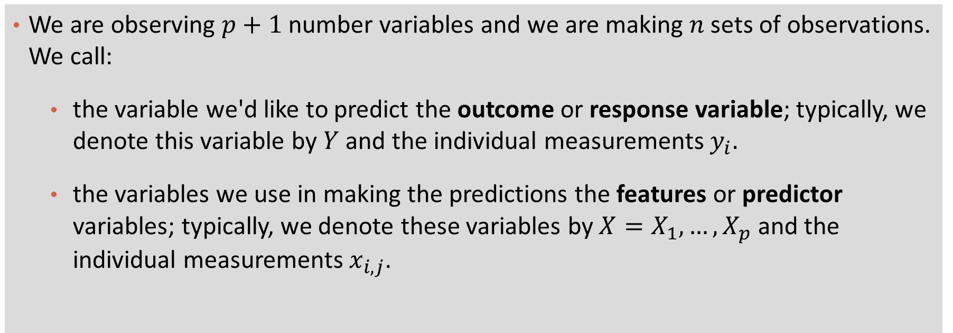
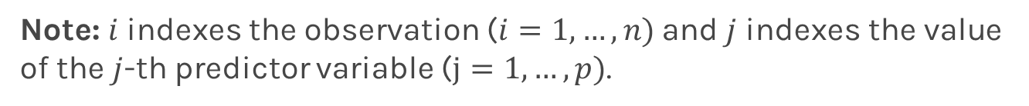
Definition

Slide 12
A typical flow to build and evaluate data science models
Training:
Given a training dataset, learn a model
Validation (optional):
Using a separate validation dataset to do model selection (e.g., hyper parameter tuning)
Test:
Apply the model to a test dataset, to evaluate the performance of the model

Slide 13

Please download and install the Slido app on all computers you use
Audience Q&A Session
ⓘ Start presenting to display the audience questions on this slide.

Slide 14
Content
The prediction problem
Simple linear regression
Multi-variate linear regression
Polynomial regression

Slide 15
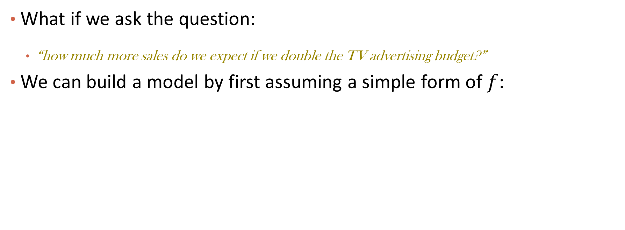
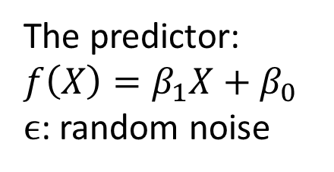
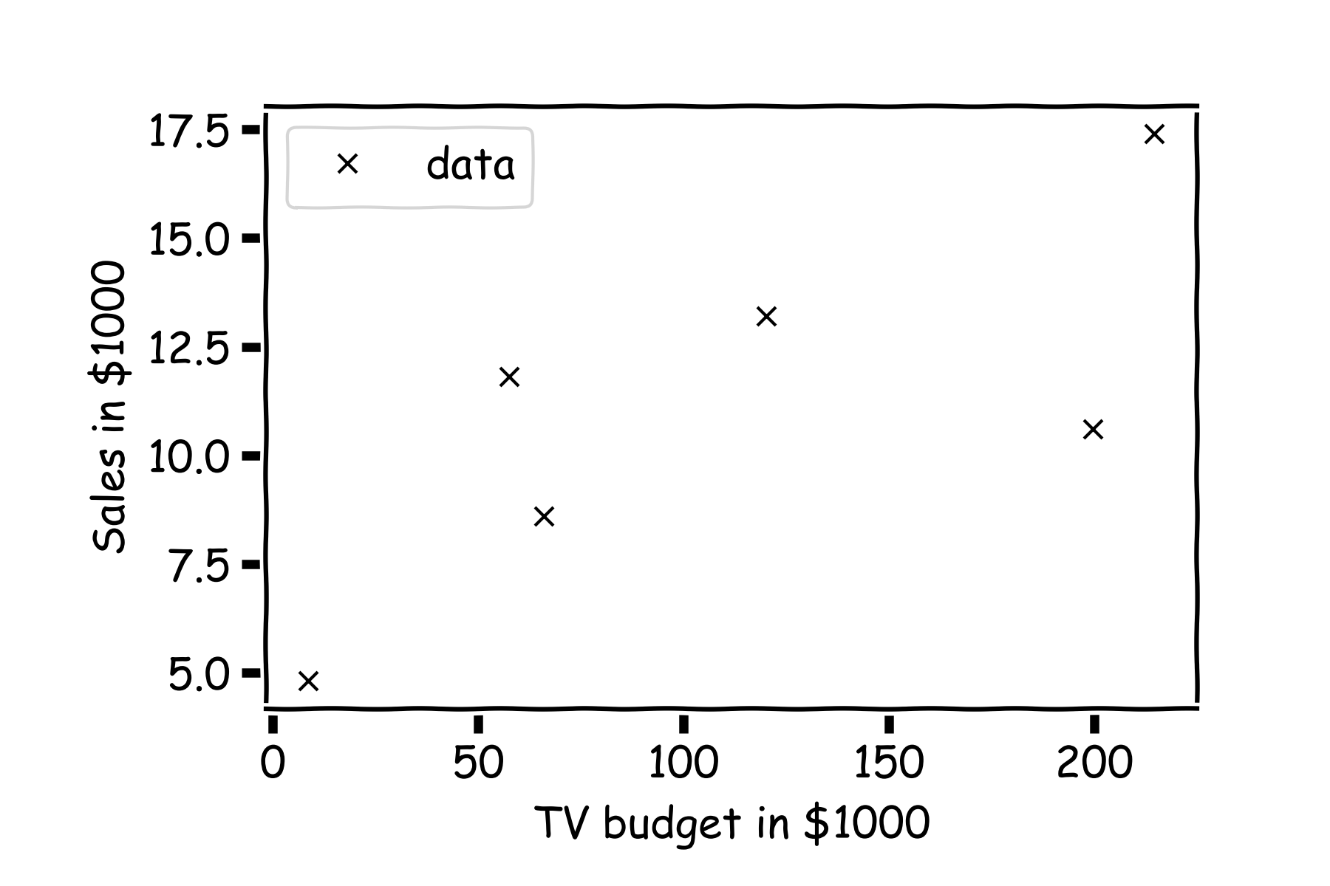
Linear Models

Slide 16
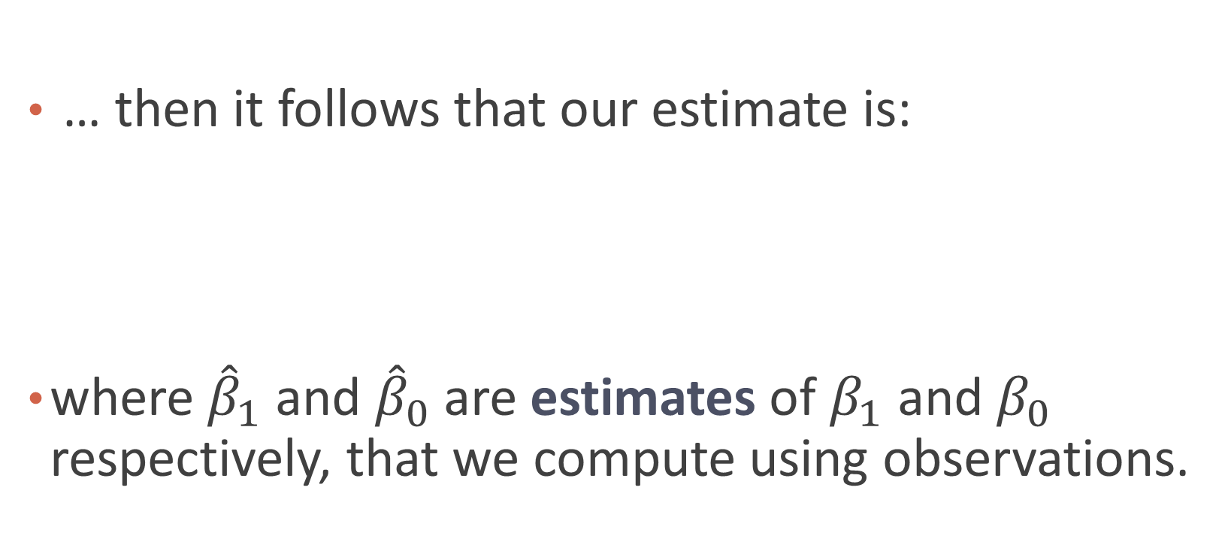
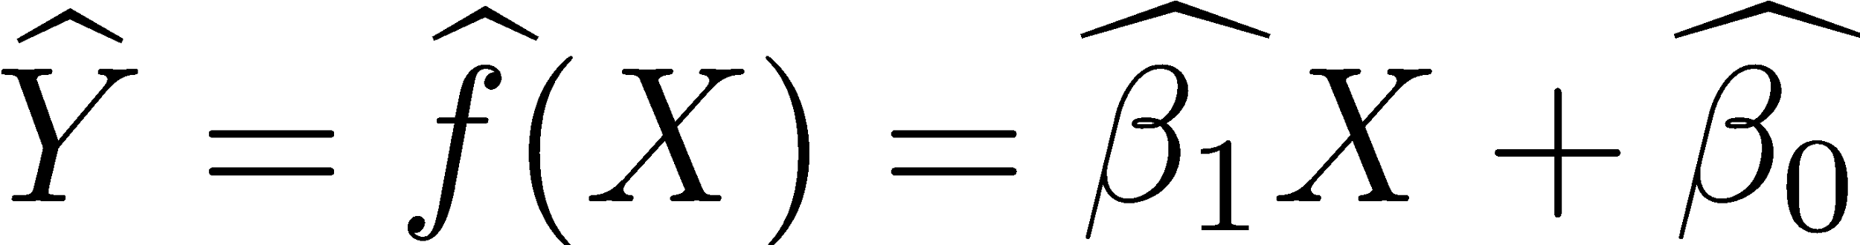
Linear Regression

Slide 17
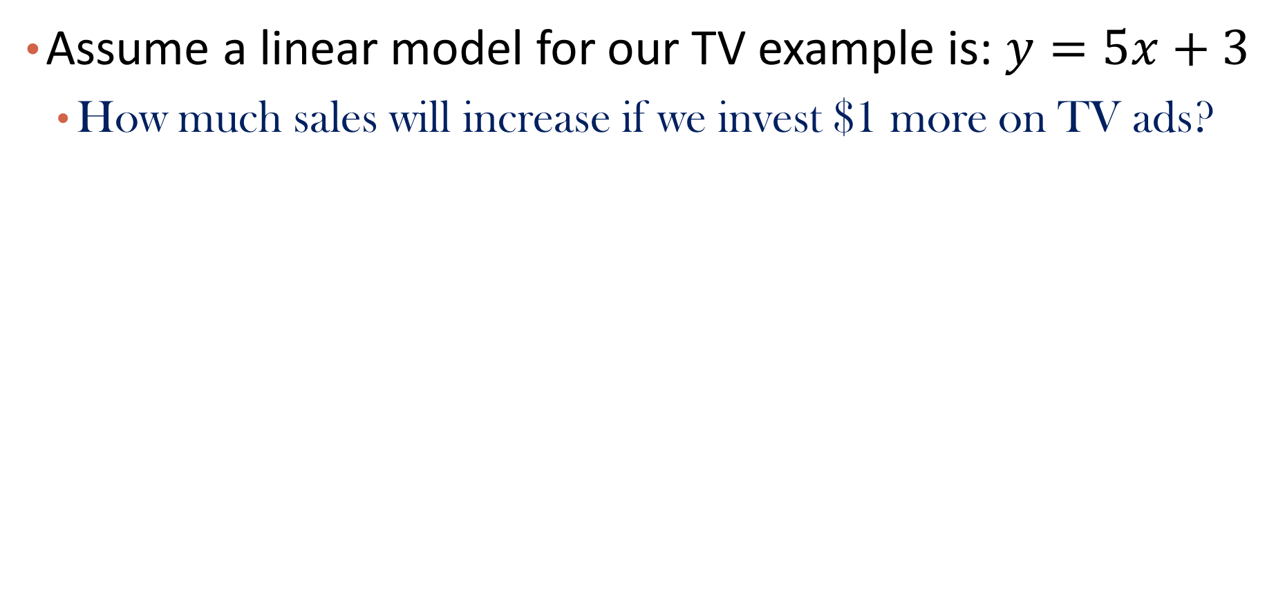
Example

Slide 18
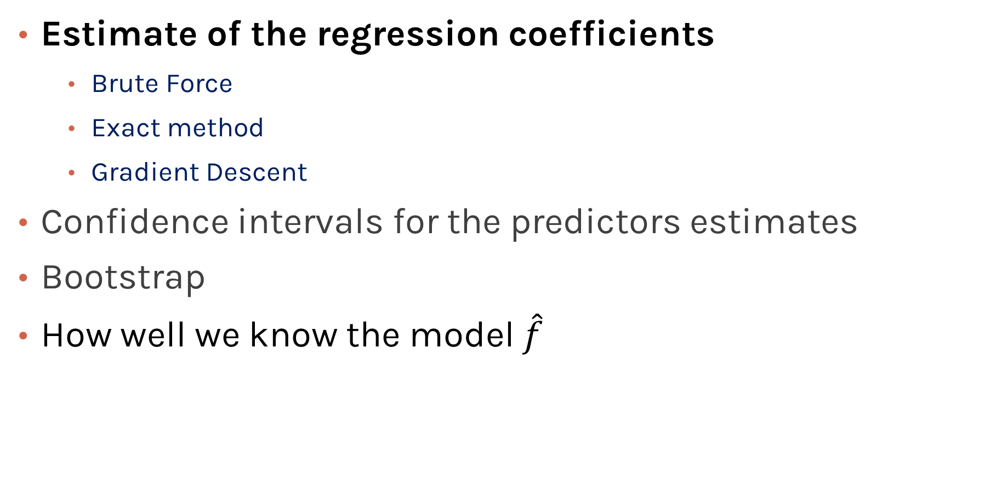
Model Estimation and Interpretation

Slide 19
Estimate of the regression coefficients
For a given data set

Slide 20
Estimate of the regression coefficients (cont)
Is this line good?

Slide 21
Estimate of the regression coefficients (cont)
Maybe this one?

Slide 22
Estimate of the regression coefficients (cont)
Or this one?

Slide 23
Question
Which line is better?
How to measure the goodness of a line?

Slide 24
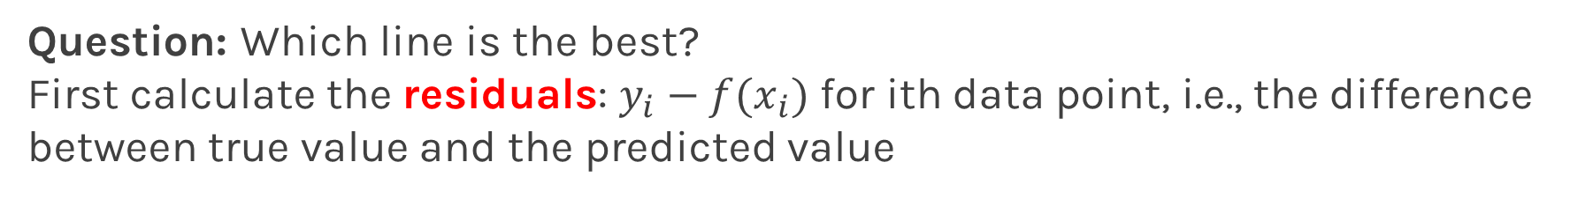
Estimate of the regression coefficients (cont)

Slide 25
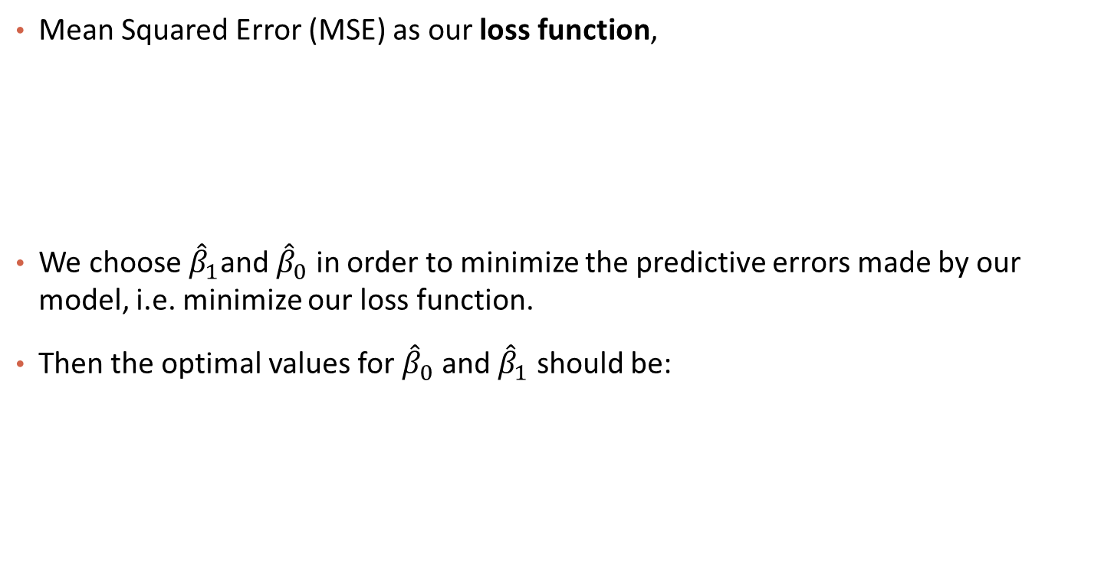
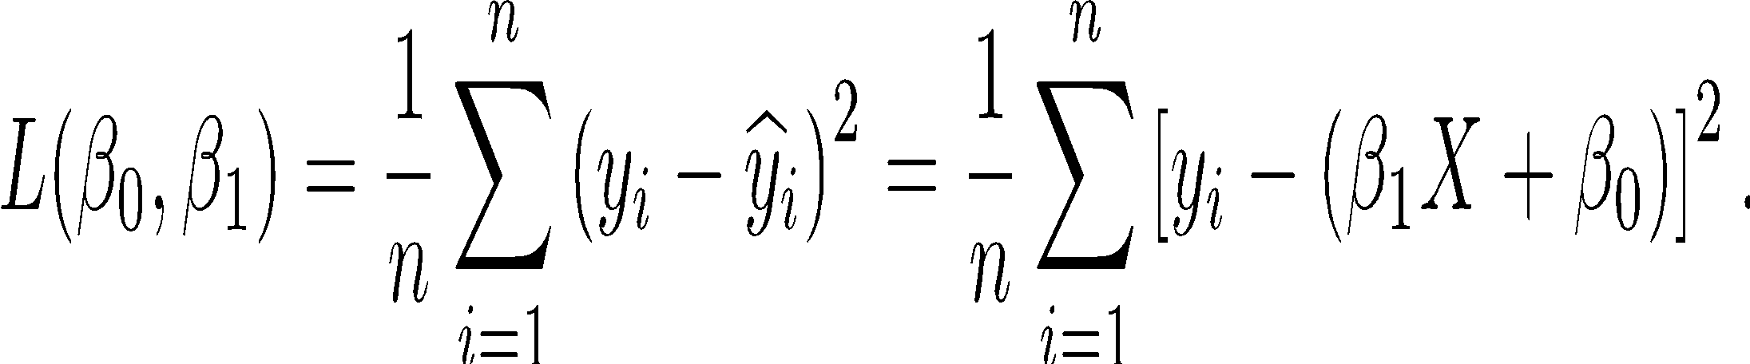
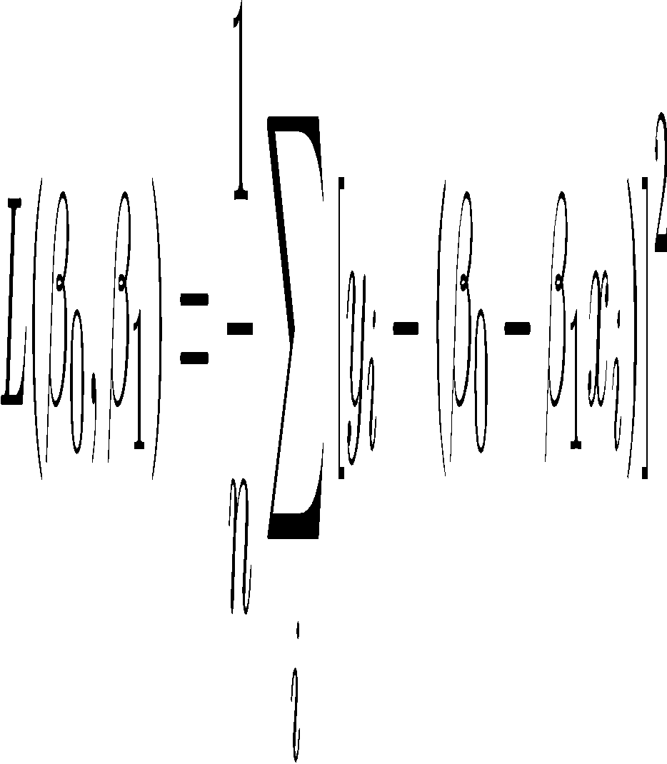
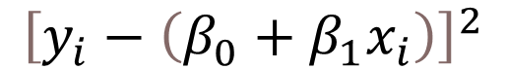
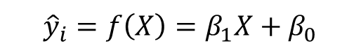
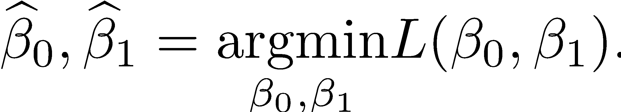
Estimate of the regression coefficients (cont)

Slide 26
Exercise: Residual and Loss Calculation
Consider the linear model y = 5x + 3, fill in the table
What is the MSE?
If we are given a different dataset, will the MSE loss be different?
x | y | Residual/error | Squared error
1 | 7
2 | 14
4 | 21

Slide 27
Exercise: Residual and Loss Calculation
Consider the linear model y = 5x + 3, fill in the table
What is the MSE?
If we are given a different dataset, will the MSE loss be different?
x | y | Residual/error | Squared error
1 | 7 | -1 | 1
2 | 14 | 1 | 1
4 | 21 | -2 | 4

Slide 28
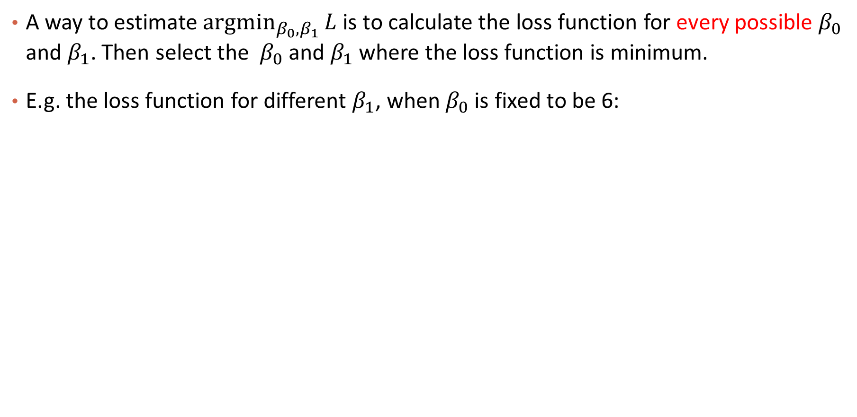
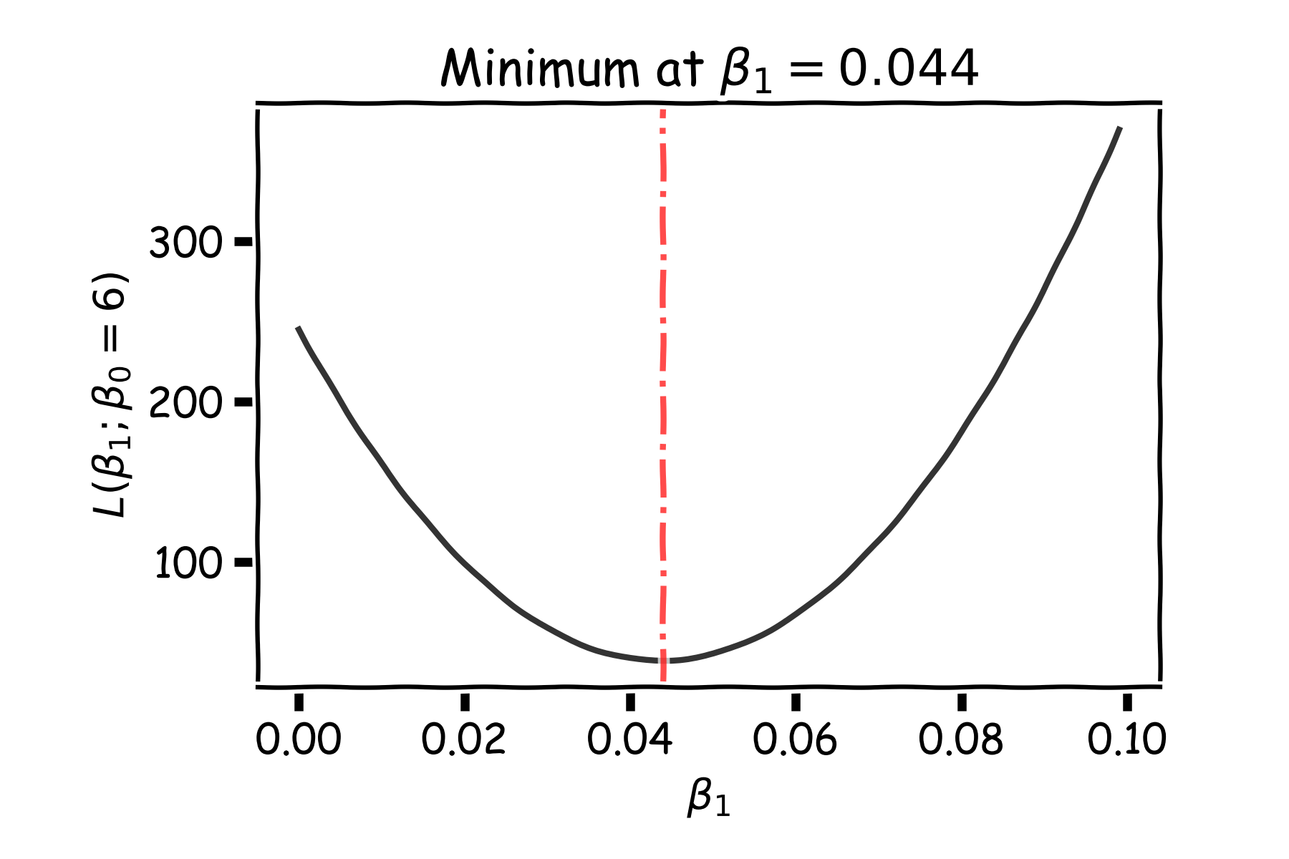
Estimate of the regression coefficients: brute force
Notes:
Shall I add a contour plot?

Slide 29
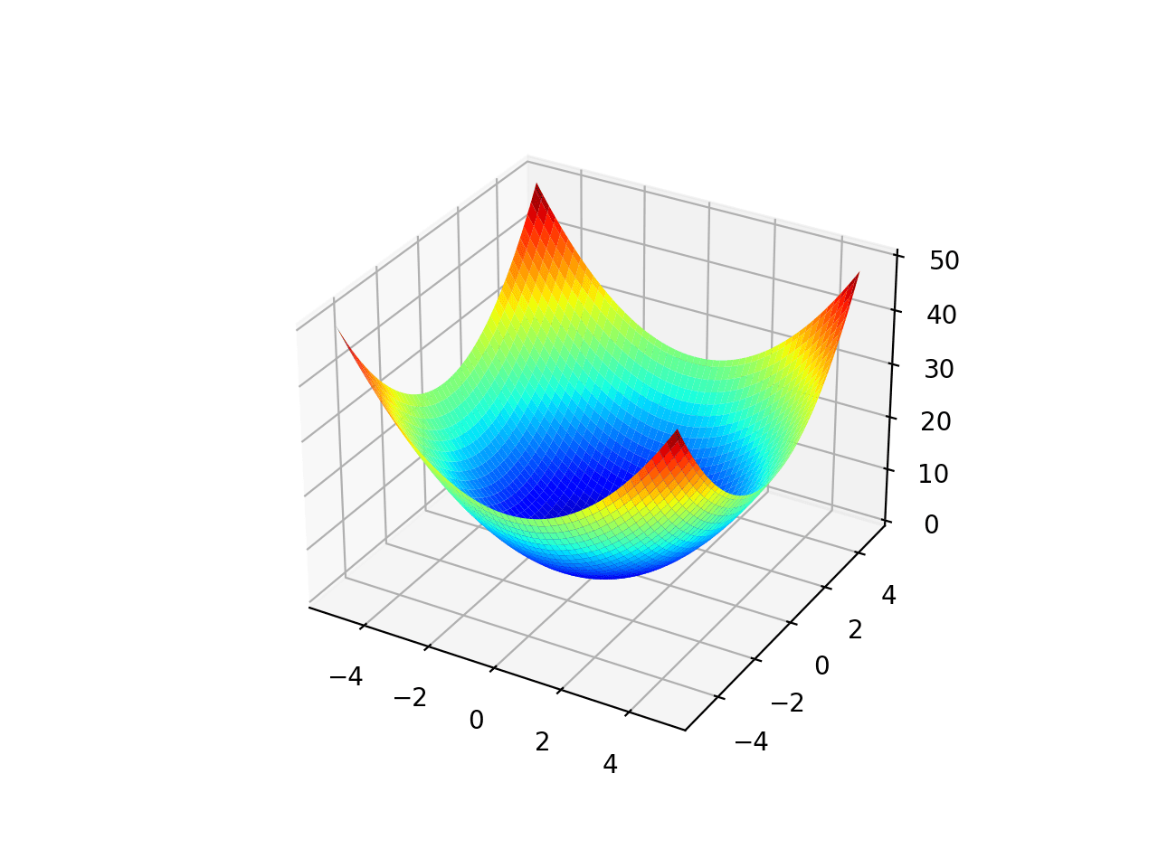
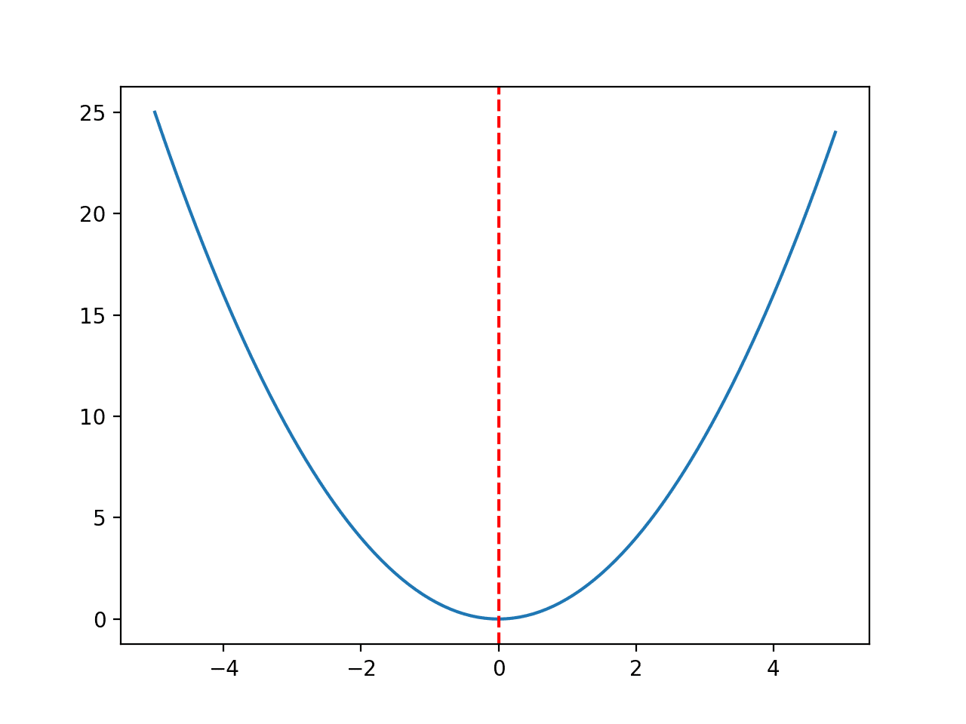
A better way?
Brute force needs to enumerate all possible parameters
Not feasible in practice
Treat it as an optimization problem:

Slide 30
Let’s talk about derivative/gradient first…

Slide 31
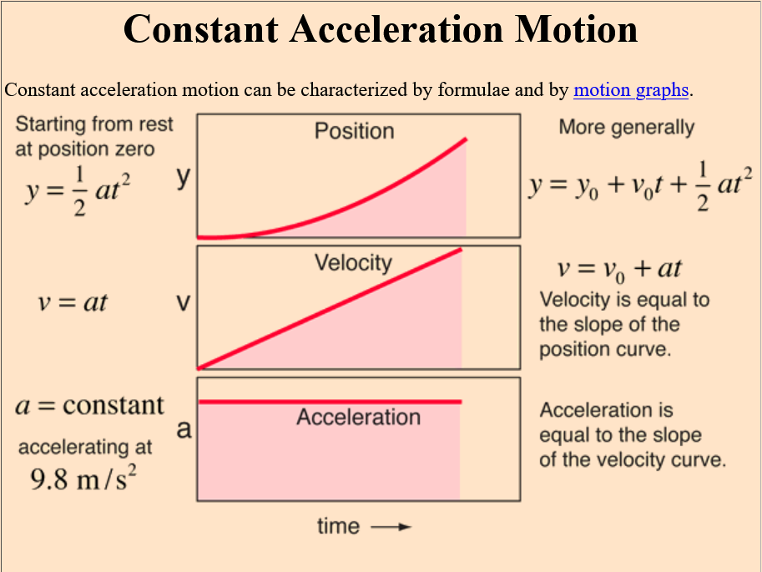
http://hyperphysics.phy-astr.gsu.edu/hbase/acons.html

Slide 32
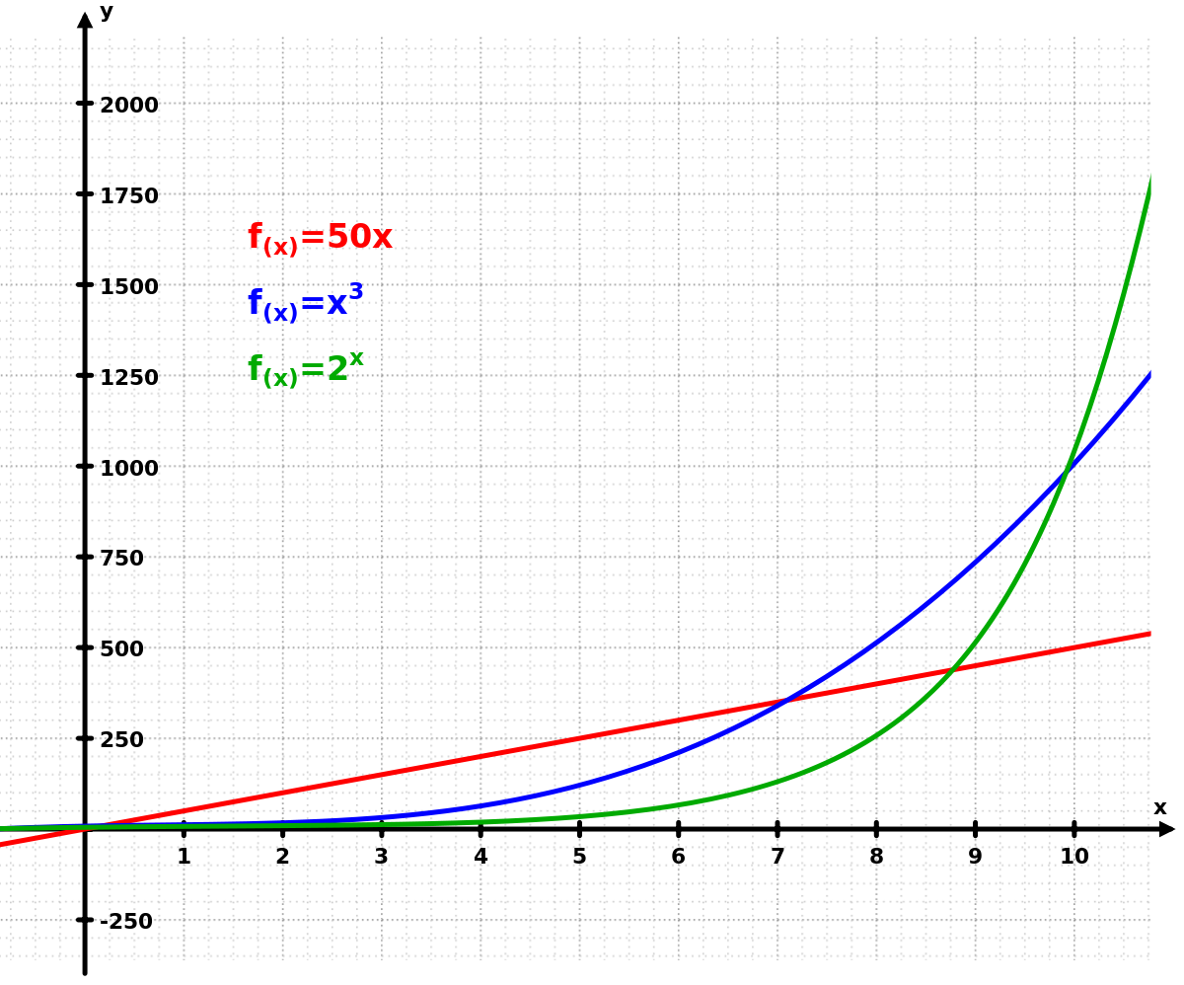
Growth Rate

Slide 33
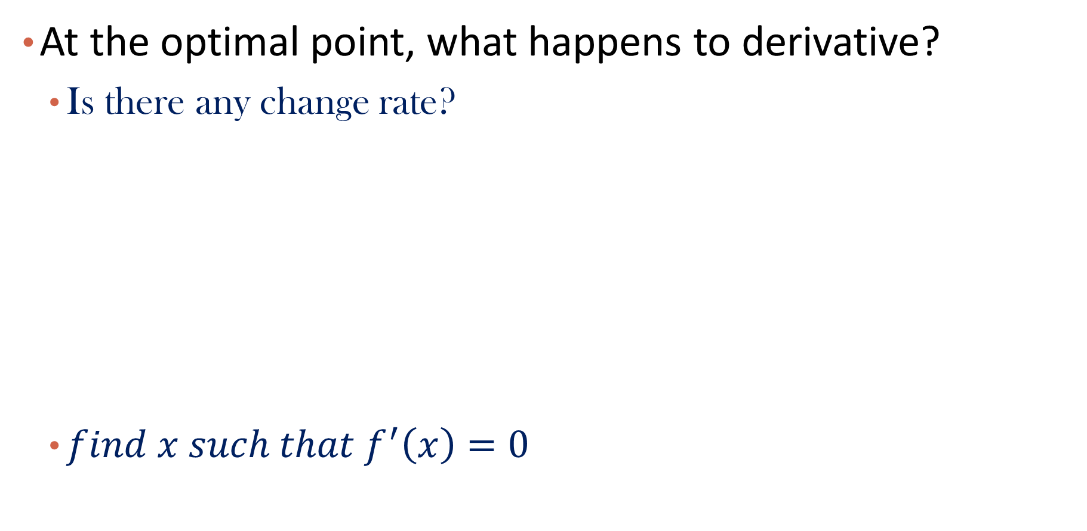
Back to optimization

Slide 34
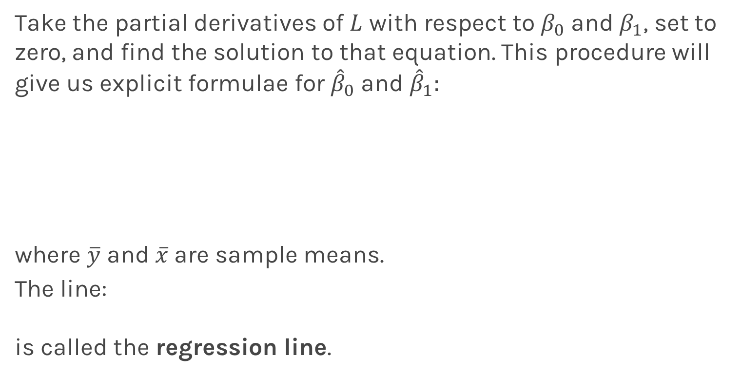
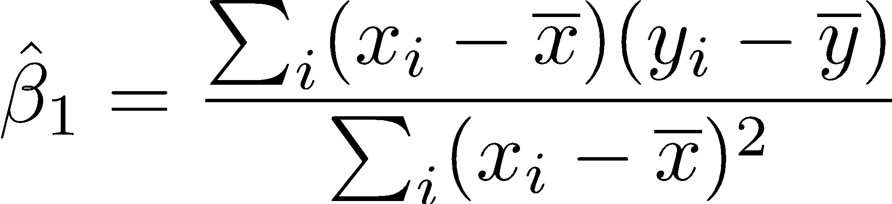
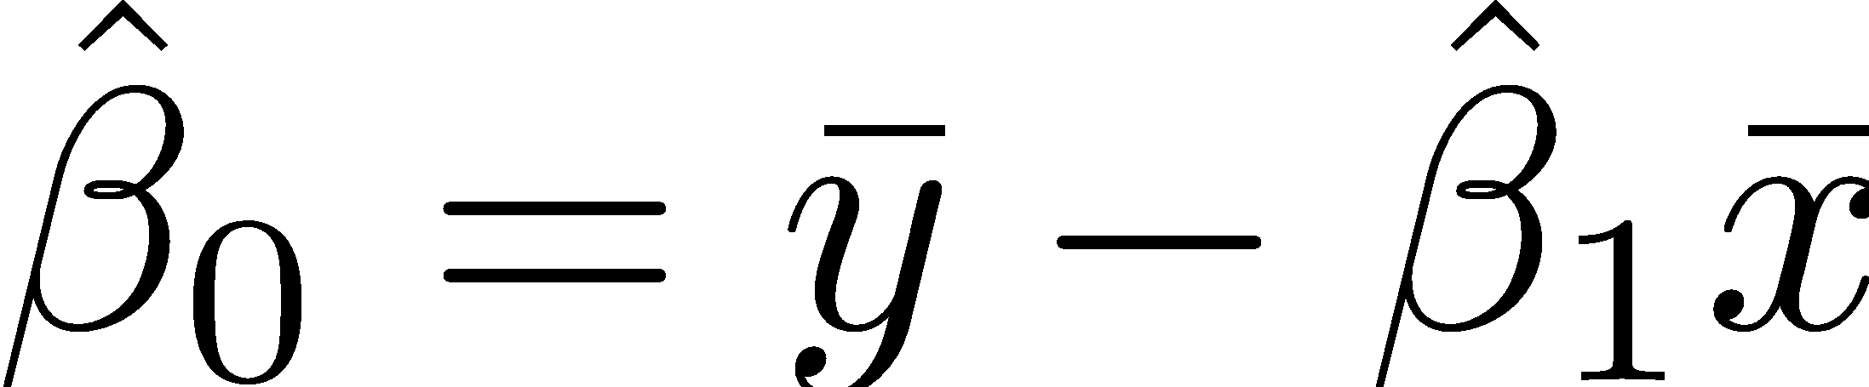
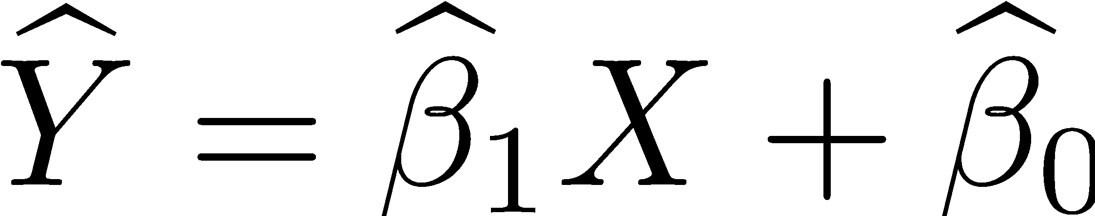
Estimate of the regression coefficients: exact method

Slide 35
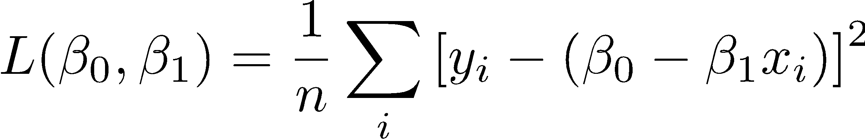
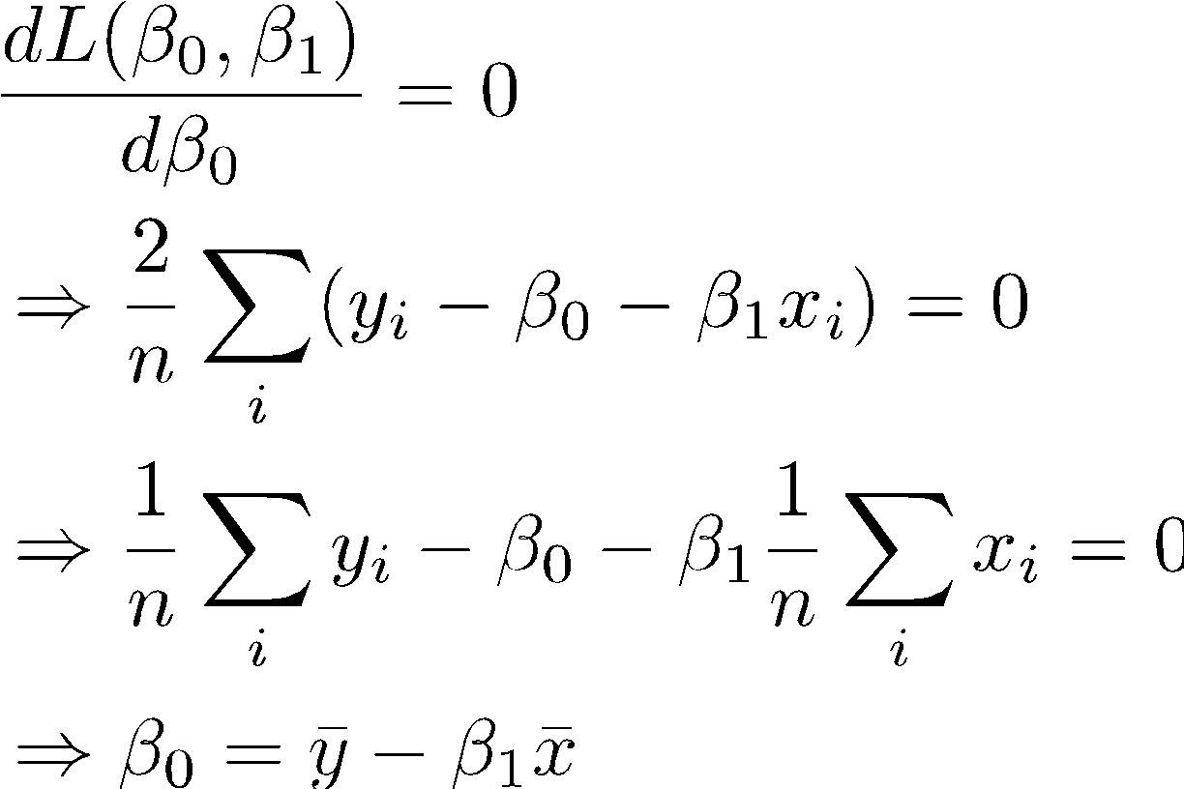
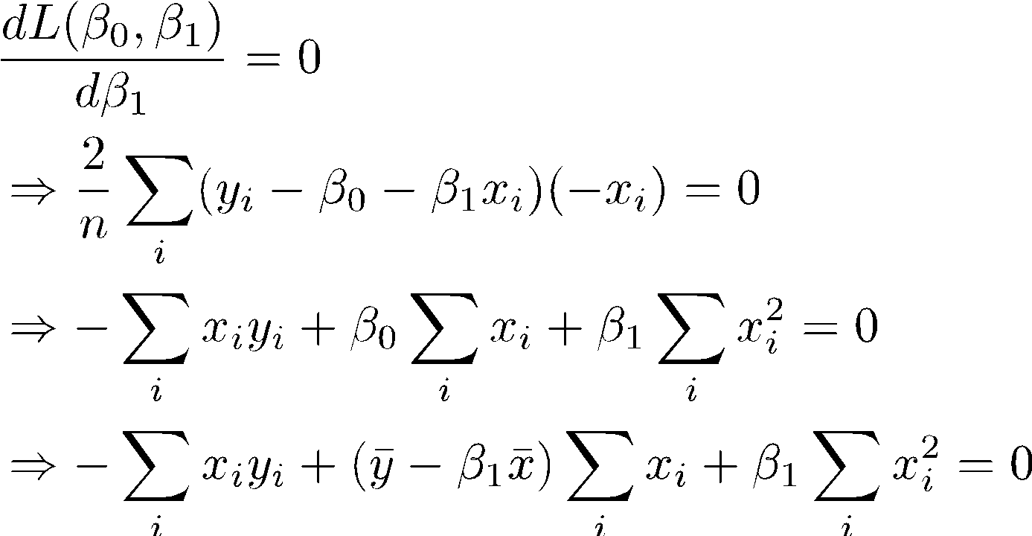
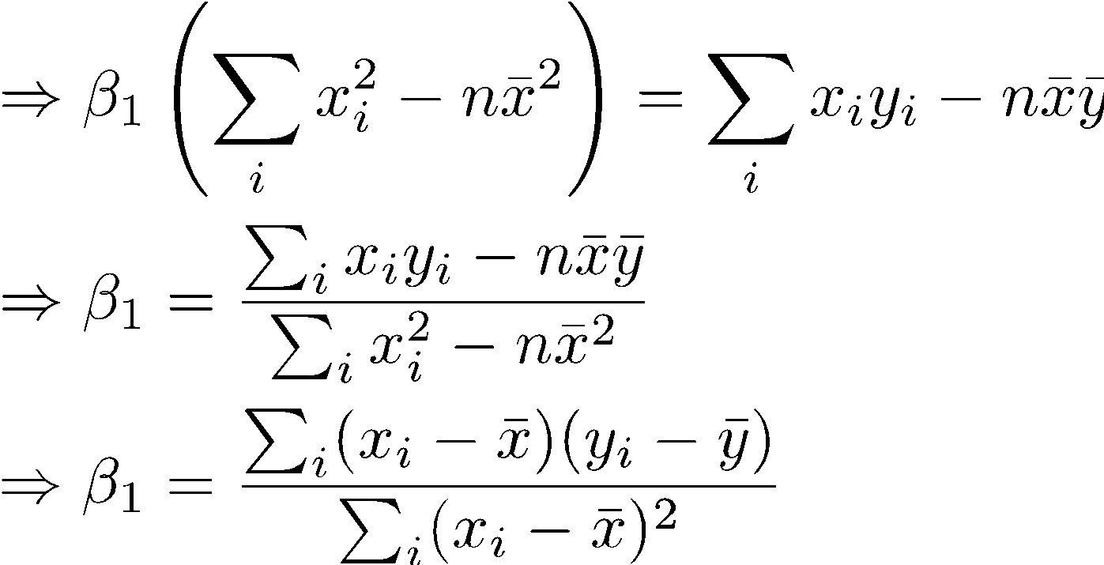
Notes:
Fix this

Slide 36
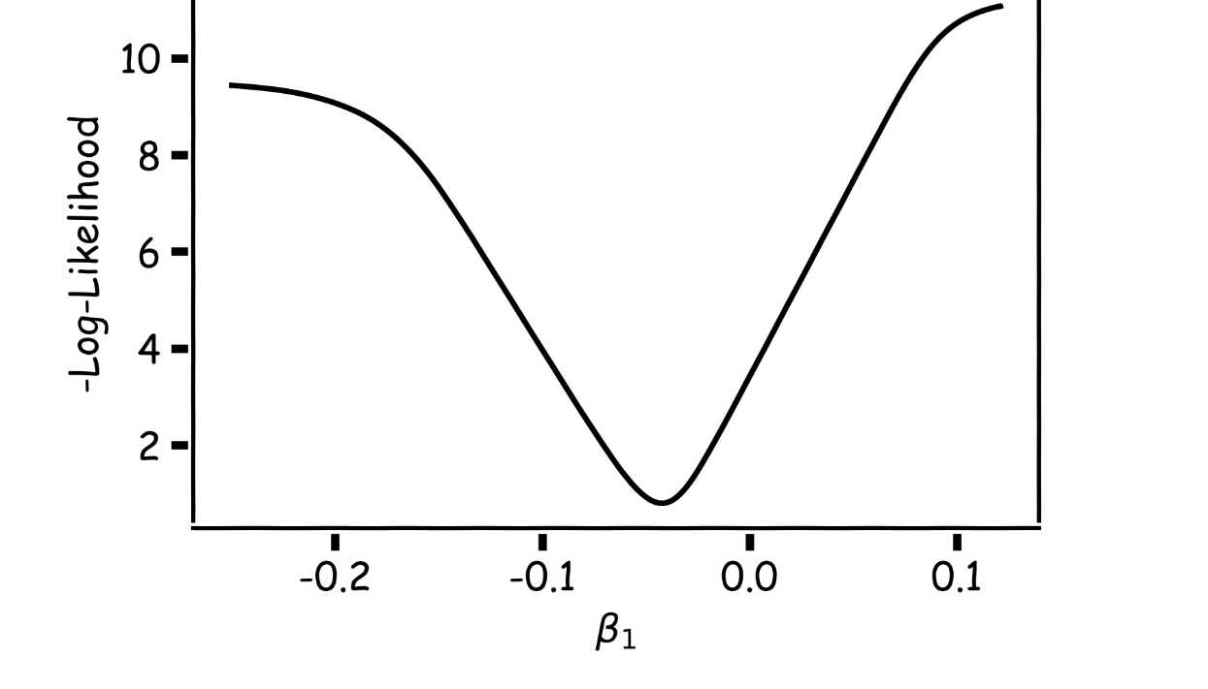
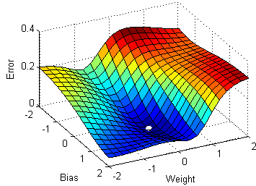
Estimate of the regression coefficients: gradient descent
A more flexible method is
Start from a random point
Determine which direction to go to reduce the loss (left or right)
Compute the slope of the function at this point and step to the right if slope is negative or step to the left if slope is positive
Goto to #1

Slide 37
Estimate of the regression coefficients: gradient descent
Question: What is the mathematical function that describes the slope?
Derivative
Question: What is a good approach for telling the model how to change (what is the step size) to become better?
If the step is proportional to the slope then you avoid overshooting the minimum
Question: How do we generalize this to more than one predictor?
Take the derivative with respect to each coefficient and do the same sequentially
Notes:
S

Slide 38
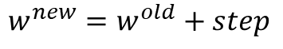
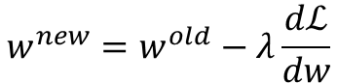
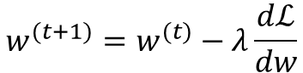
Estimate of the regression coefficients: gradient descent
We know that we want to go in the opposite direction of the derivative and we know we want to be making a step proportionally to the derivative.
Making a step means:
Learning Rate
Opposite direction of the derivative and proportional to the derivative means:
Change to more conventional notation:

Slide 39
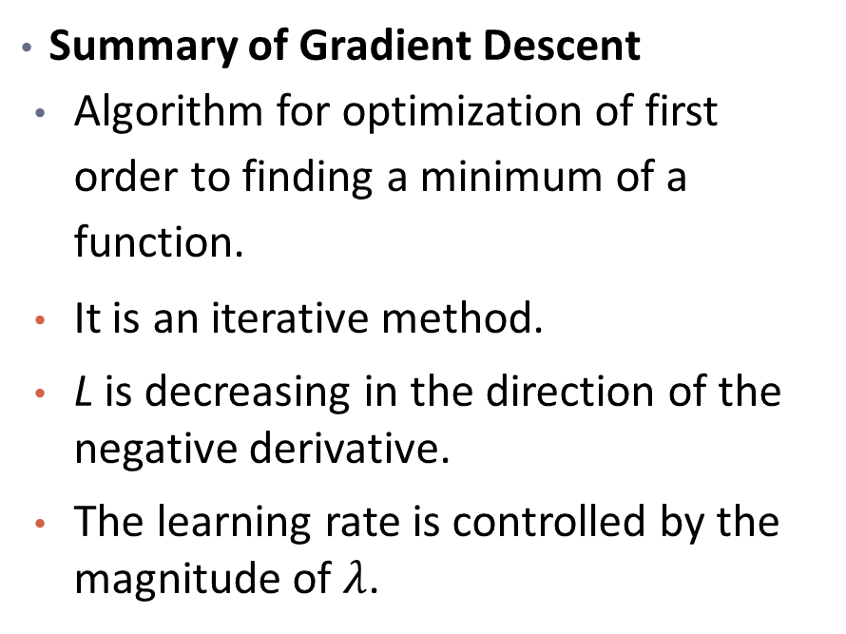
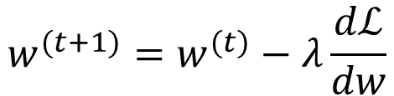
Estimate of the regression coefficients: gradient descent
L
-
+
w

Slide 40
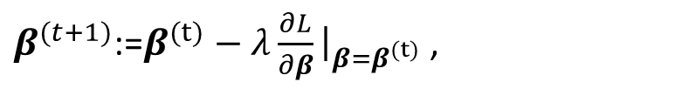
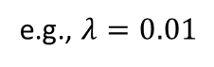
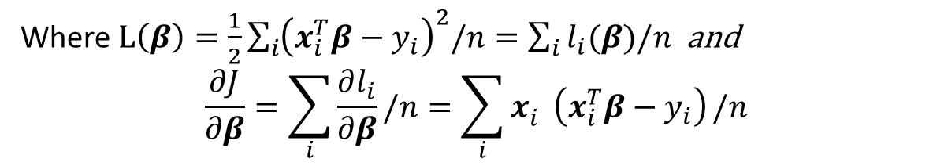
Batch Gradient Descent
Utilize all the data to calculate gradient
Move in the direction of steepest descend
Repeat until converge {
}
Total loss vs. loss of a single data point
Notes:
Consider the contribution from single data point

Slide 41
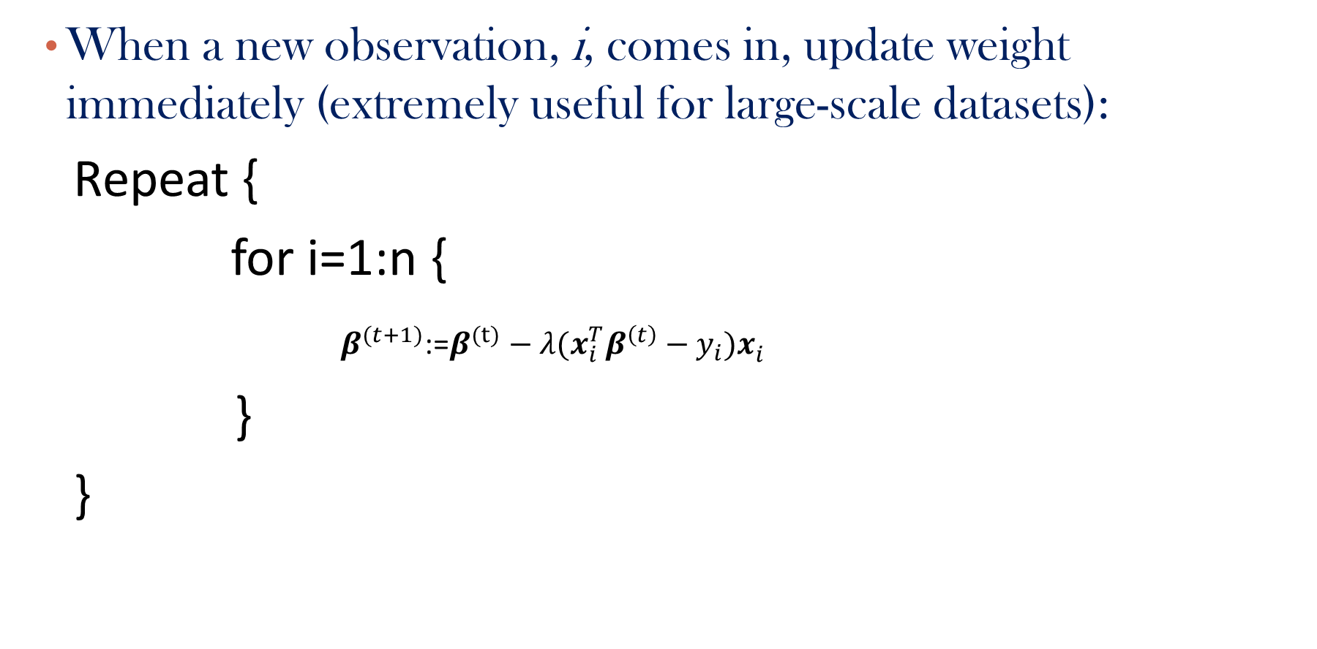
Stochastic Gradient Descent

Slide 42
Gradient Descent: considerations
Gradient Descent Considerations (more in future lectures)
We still need to derive or compute the derivatives.
We need to know what is the learning rate or how to set it.
We need to avoid local minima.
Finally, the full loss function includes summing up all individual ‘errors’. This can be hundreds of thousands of examples.
L
-
+
w

Slide 43
Gradient Descent: considerations
In linear regression, a local minima is a global minima because the loss function is convex
In linear regression, we often use the exact formula when dataset is small; in big data setting, GD & SGD is more efficient.
We will talk about optimization again in Neural Network lecture

Slide 44
Please download and install the Slido app on all computers you use
Audience Q&A Session
ⓘ Start presenting to display the audience questions on this slide.

Slide 45
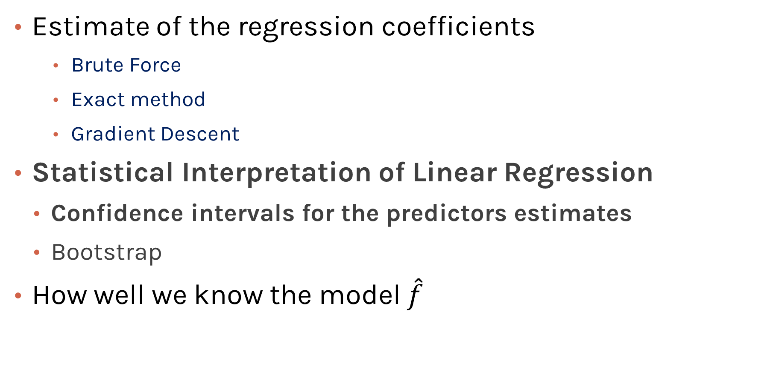
Model Estimation and Interpretation

Slide 46
A Word on Probability & Statistics
Linear Regression, Despite its simplicity, can have many different formulations:
Statistical Formulation (what we will cover)
This can be in fact challenging to understand.
Probabilistic Formulation (Prevalent in probabilistic machine learning texts)
We will have a quick overview when we talk about neural networks.
Bayesian Formulation (more advanced)
Gained lots of momentum and you will (hopefully) learn in college
Our focus will be on Frequentist Statistics (non-Bayesian), but a holistic picture is necessary nowadays.

Slide 47
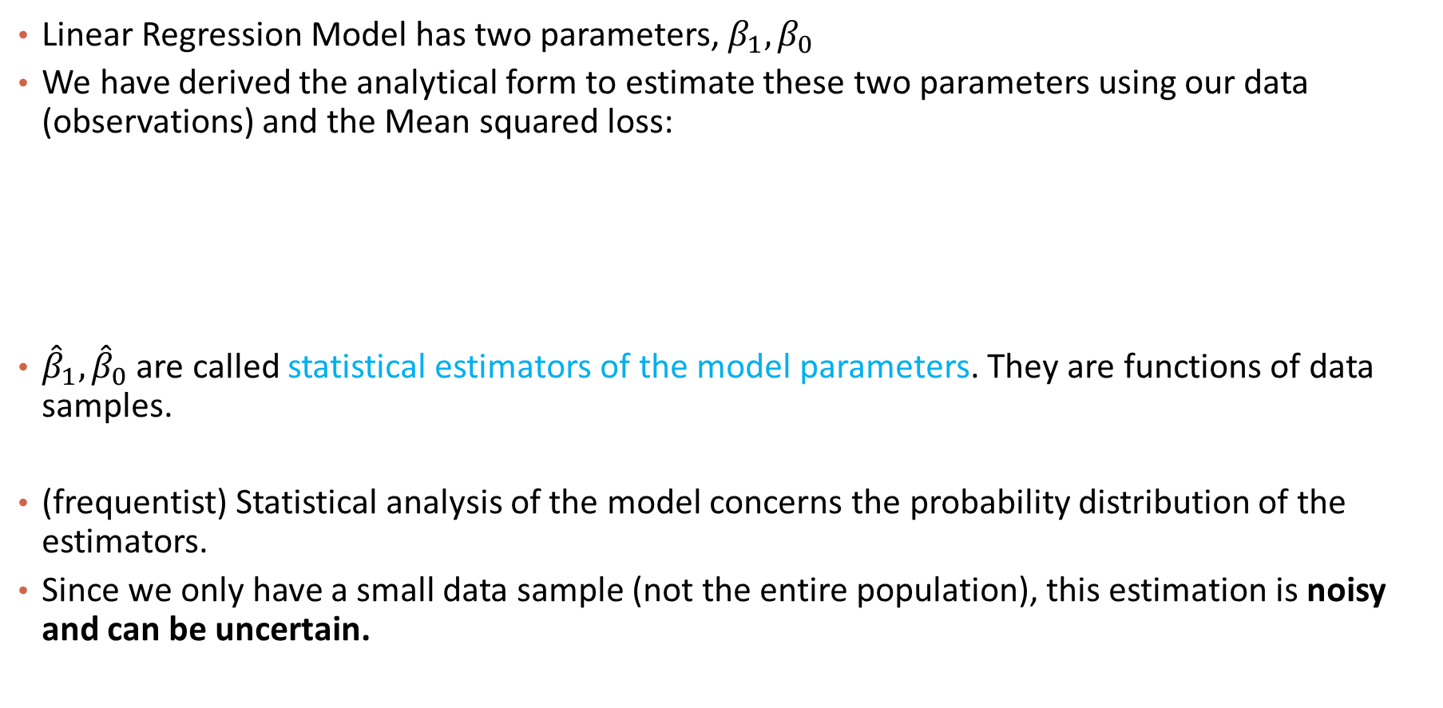
Linear Regression Statistic

Slide 48
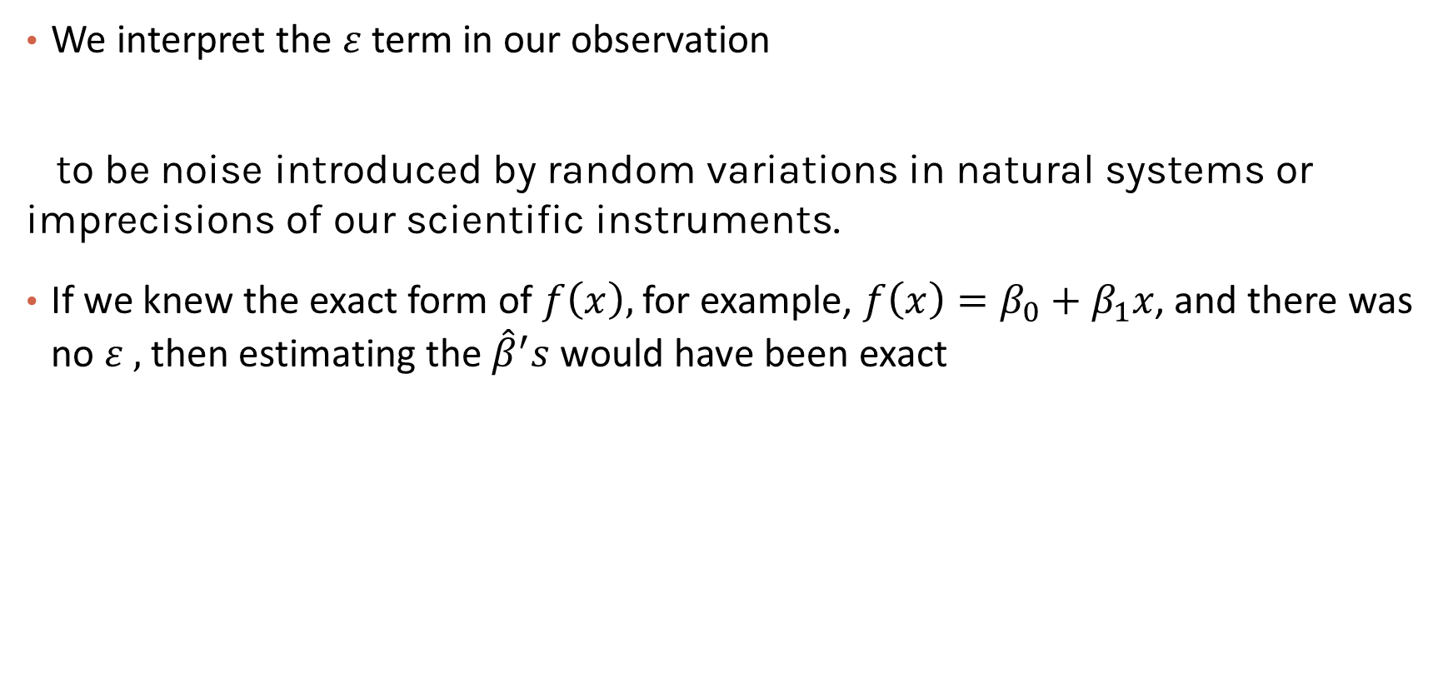
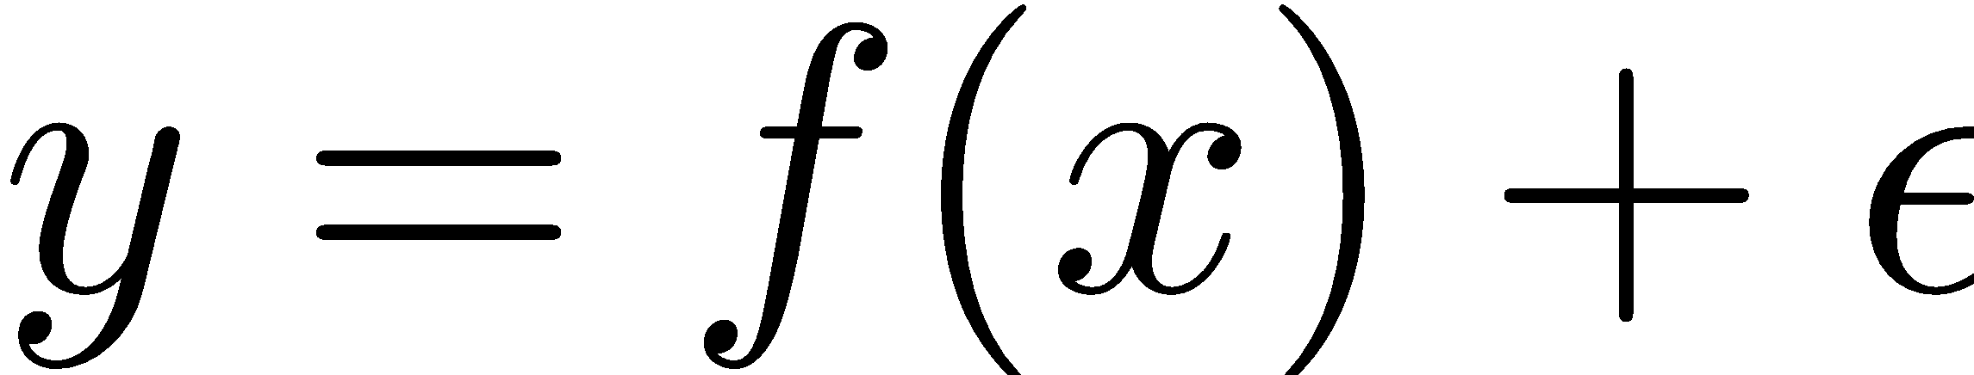
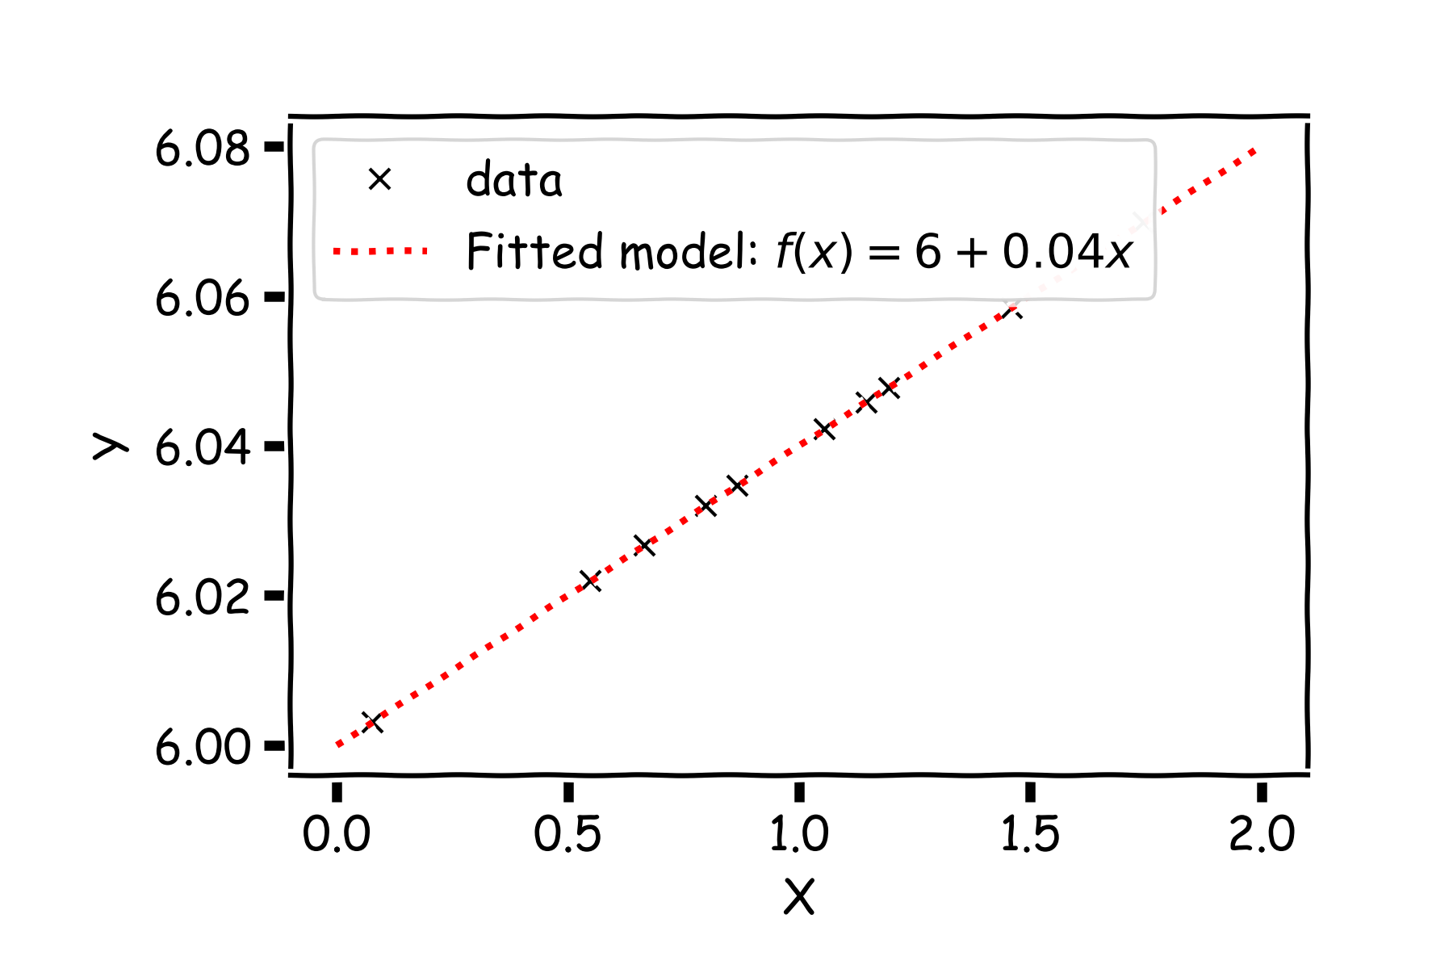
Parameter Estimation: Story So Far
Notes:
Axes labels! (DLS)

Slide 49
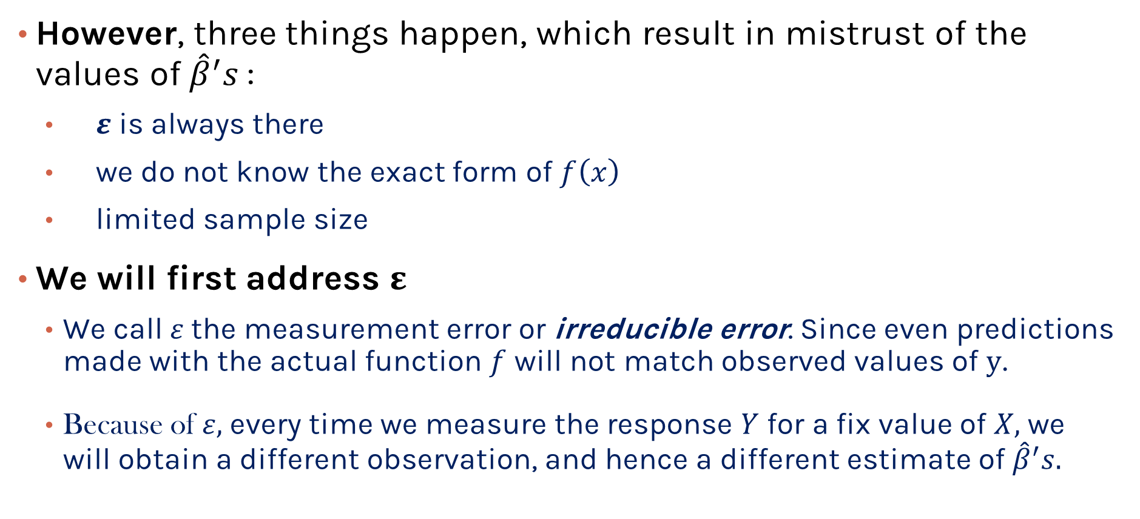
Parameter Estimation: Story So Far
Notes:
e.g. measuring the time you study/run every morning. Weight of a baby, temperature when you cook. Epsilon may be small, but it’s always there

Slide 50
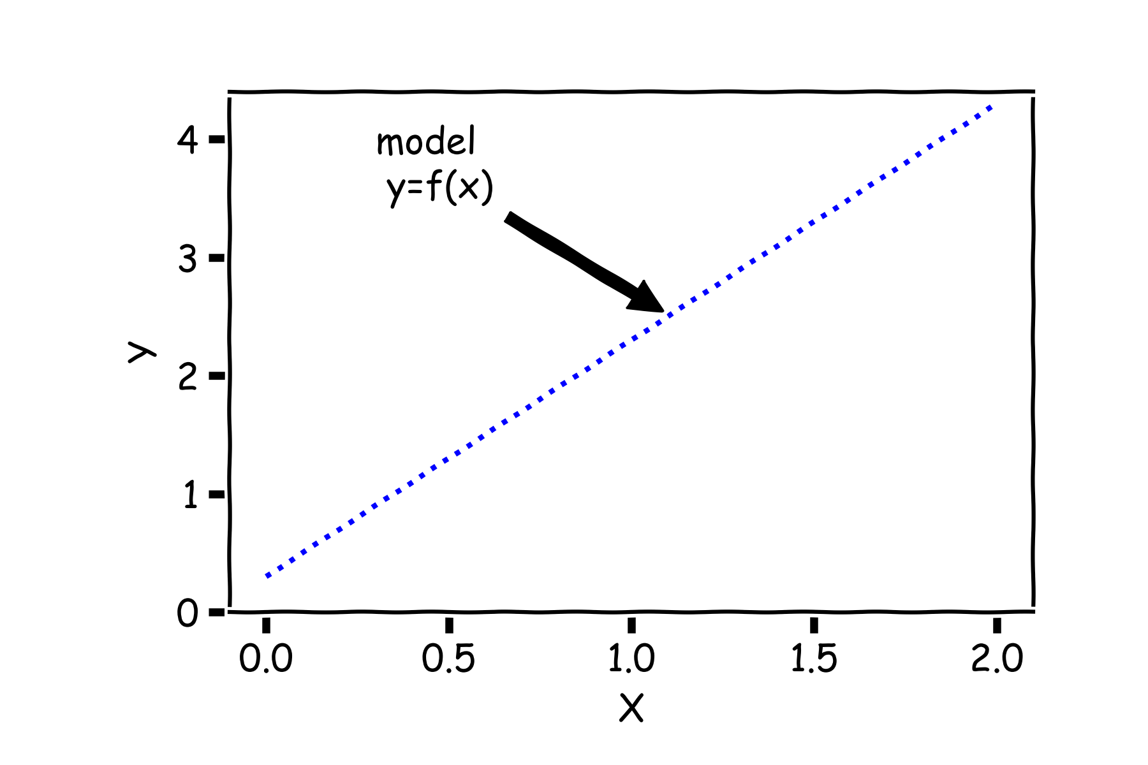
Parameter Estimation: Story So Far
Start with a model

Slide 51
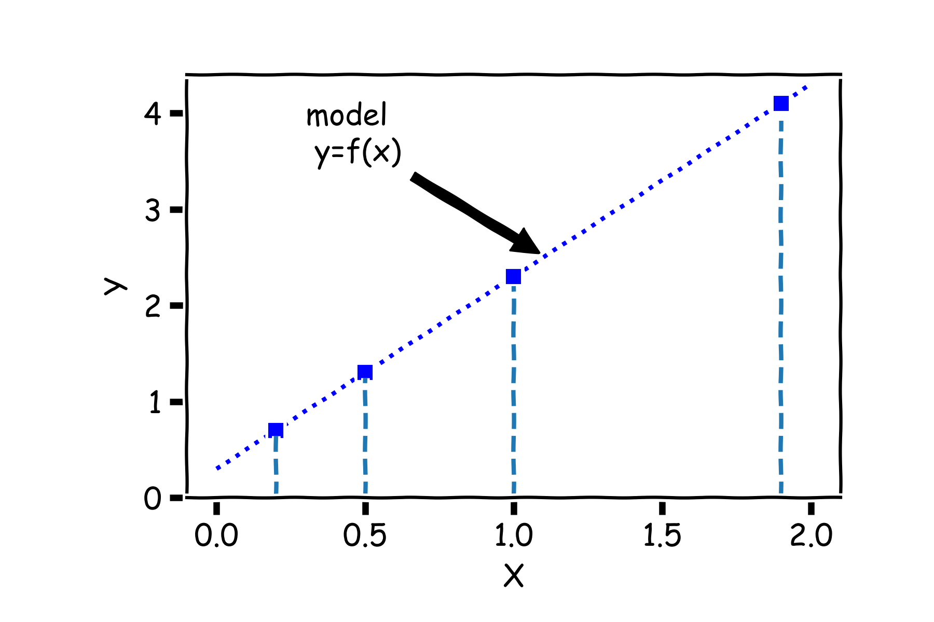
Parameter Estimation: Story So Far

Slide 52

Parameter Estimation: Story So Far
But due to error, every time we measure the response Y for a fixed value of X we will obtain a different observation.

Slide 53

Parameter Estimation: Story So Far
One set of observations, “one realization” we obtain one set of Ys (red crosses).
Terminology: realization here means the data we observed; imagine that you can generate data in real time by flipping a coin.

Slide 54

Parameter Estimation: Story So Far
Another set of observations, “another realization” we obtain another set of Ys (green crosses).

Slide 55

Parameter Estimation: Story So Far
Another set of observations, “another realization” we obtain another set of Ys (black crosses).

Slide 56


Parameter Estimation: Story So Far

Slide 57

Parameter Estimation: Story So Far

Slide 58

Parameter Estimation: Story So Far

Slide 59

Parameter Estimation: Story So Far
Universe A
Universe B
Universe C
Notes:
Gabriel García Márquez, whose novel One Hundred Years of Solitude … magic realism.

Slide 60

(Empirical) Distribution of Estimtaor
In our magical realisms, we can now sample multiple times

Slide 61

(Empirical) Distribution of Estimtaor
Another sample

Slide 62

(Empirical) Distribution of Estimtaor
Another sample

Slide 63

(Empirical) Distribution of Estimtaor
And another sample

Slide 64

(Empirical) Distribution of Estimtaor
Repeat this for 100 times

Slide 65


(Empirical) Distribution of Estimator
2

Slide 66

Confidence intervals for the predictors estimates
Finally, we can calculate the confidence intervals, which are the ranges of values such that the true value of β₁ is contained in
95%
68%

Slide 67



And also we can answer the question, ’how significant are the predictors?’ Here we show the same analysis for all three predictors.
Question: Which ones are important?
Before we answer this question, we need to answer another question.

Slide 68

Interpretation of Predictors
The interpretation of the predictors depends on the values but decisions depend on how much we trust these values.
Notes:
Axes labels! (DLS)
Advantage: Interpretability for regression.
The sign of each coefficient indicates the direction of the relationship between a predictor variable and the response variable.
- A positive sign indicates that as the predictor variable increases, the response variable also increases.
- A negative sign indicates that as the predictor variable increases, the response variable decreases.
The coefficient value represents the mean change in the response given a one unit change in the predictor. For example, if a coefficient is +3, the mean response value increases by 3 for every one unit change in the predictor.

Slide 69

Model Estimation and Interpretation

Slide 70
Bootstrap
The frequentist approach is inherently data-hungry: the more data we have, the more certain we are about the estimation.
With only a small (or finite) dataset, we need a way of producing
(fake) data set that also “makes sense”.
Bootstrapping is the practice of sampling from the observed data (X,Y) in estimating statistical properties.

Slide 71





Bootstrap
Imagine we have 4 billiard balls in a bucket.

Slide 72
Bootstrap
We first pick randomly a ball and replicate it. This is called sampling with replacement.
We move the replicated ball to another bucket.

Slide 73
Bootstrap

Slide 74
Bootstrap
We then randomly pick another ball and again we replicate it.
As before, we move the replicated ball to the other bucket.

Slide 75
Bootstrap

Slide 76
Bootstrap
We repeat this process.
Notes:
Fix this with true replacement

Slide 77
Bootstrap
Again

Slide 78
Bootstrap
And again

Slide 79
Bootstrap
Until the “other” bucket has the same number of balls as the original one.
This new bucket represents a new parallel universe

Slide 80
Bootstrap
We repeat the same process and acquire another sample.

Slide 81
Bootstrap
We repeat the same process and acquire another sample.
These new buckets represents the parallel universes

Slide 82

Bootstrapping for Estimating Sampling Error
Definition

Slide 83

Confidence intervals for the predictors estimates: Standard Errors
Notes:
If data set is small this approximation does not work

Slide 84

And also we can answer the question, ’how significant are the predictors?’ Here we show the same analysis for all three predictors.
Question: Which ones are important?

Slide 85




Slide 86

Here we show two difference set of models given the fitted coefficients.

Slide 87

There is one such regression line for every bootstrapped sample.

Slide 88


Below we show all regression lines for a thousand of such bootstrapped samples.

Slide 89


Below we show all regression lines for a thousand of such samples.

Slide 90

Below we show all regression lines for a thousand of such samples.

Slide 91



Slide 92



Slide 93



Slide 94



Slide 95

Confused?

Slide 96
Nice Try!
This statistical understanding of linear regression already touches the core of classical statistical inference (which is the cornerstone of statistics classes in college)!
Mastering this way of thinking and analyzing statistical models takes time.
If you feel a little bit overwhelmed, it is normal—reach out to us if you are lost!

Slide 97
Please download and install the Slido app on all computers you use
Audience Q&A Session
ⓘ Start presenting to display the audience questions on this slide.

Slide 98

So far …

Slide 99
Content
The prediction problem
Simple linear regression
Multi-variate linear regression
Polynomial regression

Slide 100
Multiple Linear Regression
If you have to guess someone's height, would you rather be told
Their weight, only
Their weight and gender
Their weight, gender, and income
Their weight, gender, income, and favorite number
Of course, you'd always want as much data about a person as possible. Even though height and favorite number may not be strongly related, at worst you could just ignore the information on favorite number. We want our models to be able to take in lots of data as they make their predictions.

Slide 101
Response vs. Predictor Variables
X
predictors
features
covariates
Y
outcome
response variable
dependent variable
TV | radio | newspaper | sales
230.1 | 37.8 | 69.2 | 22.1
44.5 | 39.3 | 45.1 | 10.4
17.2 | 45.9 | 69.3 | 9.3
151.5 | 41.3 | 58.5 | 18.5
180.8 | 10.8 | 58.4 | 12.9
n observations
p predictors

Slide 102

Multilinear Models

Slide 103



Multiple Linear Regression
Notes:
We need a figure here

Slide 104





Multilinear Model, example

Slide 105

Multilinear Model, An Example

Slide 106



Multiple Linear Regression
The model takes a simple algebraic form:
Thus, the MSE can be expressed in vector notation as
Minimizing the MSE using vector calculus yields,
Notes:
We need a figure here

Slide 107
Qualitative Predictors
So far, we have assumed that all variables are quantitative. But in practice, often some predictors are qualitative.
Example: The Credit data set contains information about balance, age, cards, education, income, limit , and rating for a number of potential customers.
Income | Limit | Rating | Cards | Age | Education | Gender | Student | Married | Ethnicity | Balance
14.890 | 3606 | 283 | 2 | 34 | 11 | Male | No | Yes | Caucasian | 333
106.02 | 6645 | 483 | 3 | 82 | 15 | Female | Yes | Yes | Asian | 903
104.59 | 7075 | 514 | 4 | 71 | 11 | Male | No | No | Asian | 580
148.92 | 9504 | 681 | 3 | 36 | 11 | Female | No | No | African American | 964
55.882 | 4897 | 357 | 2 | 68 | 16 | Male | No | Yes | Caucasian | 331

Slide 108

Qualitative Predictors
If the predictor takes only two values, then we create an indicator or dummy variable that takes on two possible numerical values.
For example for the gender, we create a new variable:
We then use this variable as a predictor in the regression equation.

Slide 109

Qualitative Predictors

Slide 110


More than two levels: One hot encoding
Often, the qualitative predictor takes more than two values (e.g. ethnicity in the credit data).
In this situation, a single dummy variable cannot represent all possible values.
We create additional dummy variable as:

Slide 111


More than two levels: One hot encoding
Notes:
[ADD interpretation and ONE HOT ENCODING]

Slide 112

Beyond linearity

Slide 113
Beyond linearity
We change
To

Slide 114
Content
The prediction problem
Simple linear regression
Multi-variate linear regression
Polynomial regression

Slide 115
Predictors predictors predictors
We have a lot of predictors!
Is it a problem?
Yes: Computational Cost
Yes: Overfitting
Wait there is more …
Notes:
Understandability
If you are dealing with many predictor variables, then the chances are high that there are hidden relationships between some of them
even when you have a large number of relevant predictor variables, it is a good idea to work with fewer predictors (shortlisted through feature selection or developed through feature extraction). This is essentially similar to the Pareto principle, which states that for many events, roughly 80% of the effects come from 20% of the causes.
Focusing on those 20% most significant predictor variables will be of great help in building data models with considerable success rate in a reasonable time, without needing non-practical amount of data or other resources.
overfitting a regression model occurs when you attempt to estimate too many parameters from a sample that is too small.
a good rule of thumb is to have 10-15 observations per term in multiple linear regression.

Slide 116


Polynomial Regression

Slide 117

Polynomial Regression
Again, minimizing the MSE using vector calculus yields,

Slide 118

Polynomial Regression (cont)

Slide 119

Polynomial Regression (cont)

Slide 120

Polynomial Regression (cont)

Slide 121

Polynomial Regression (cont)

Slide 122

Polynomial Regression (cont)

Slide 123

Polynomial Regression (cont)

Slide 124

Overfitting
In statistics, overfitting is "the production of an analysis that corresponds too closely or exactly to a particular set of data, and may therefore fail to fit additional data or predict future observations reliably”
More on this next lecture

Slide 125
Summary
Linear regression
Response is a linear function of predictors
Estimation
Standard error
Coefficient significance
Brings more predictors
Multiple responses
Interaction terms
Polynomial regression

Slide 126
Please download and install the Slido app on all computers you use
Audience Q&A Session
ⓘ Start presenting to display the audience questions on this slide.

